Slide 1
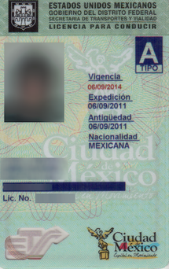
Foreign licenses and the new law: SB 501 (6/6/16)
Michigan Immigrant Rights Center
3030 S. 9th Street, Kalamazoo MI, 49009
Susan Reed
269-216-5577
susanree@michigan
immigrant.org

Slide 2
Driving with a foreign license in Michigan
All “residents” of Michigan have to have a valid Michigan driver’s license
To be eligible for a Michigan license, one must prove either U.S. citizenship or legal immigration status
But, the Michigan Vehicle Code also says at Sec. 257.51a: “"Resident" means every person who resides in this state and establishes that he or she is legally present in the United States. This definition applies to the provisions of this act only.”

Slide 3
Countries that recognize the treaty: “Legal presence” not required
1943: Commercial & Non- Commercial
Dominican Rep.
Ecuador
Egypt
Fiji
Finland
France
Gambia
Georgia
Ghana
Grenada
Guyana
Haiti
Hong Kong
Hungary
Iceland
India
Ireland
Israel
Italy
Jamaica
Japan
Swaziland
Sweden
Syrian Arab Rep.
Tanzania
Thailand
Taiwan
Togo
Trinidad & Tobago
Tunisia
Turkey
Uganda
United Arab Emirates
United Kingdom
Vatican City
Venezuela
Vietnam Rep.
Western Samoa
Yugoslavia
Zambia
Zimbabwe
Brazil
Colombia
Costa Rica
El Salvador
Honduras
México
Nicaragua
Panamá
Uruguay
Albania
Algeria
Central African Rep.
Chile
Congo
Congo Democratic Rep.
Cote d’Ivoire
Cuba
Cyprus
Czech Rep.
Denmark
Jordan
Korea
Kyrgyz Rep.
Laos
Lebanon
Lesotho
Luxembourg
Macao
Madagascar
Malawi
Malaysia
Mali
Malta
Mauritius
Monaco
Morocco
Namibia
Netherlands
New Zealand
Niger
Nigeria
Norway
Papua New Guinea
Paraguay
Peru
Philippines
Poland
Portugal
Romania
Russian Federation
Rwanda
St. Lucia
St. Vincent & The Grenadines
San Marino
Senegal
Serbia & Montenegro
Seychelles
Sierra Leone
Singapore
Slovak Rep.
South Africa
Spain
Sri Lanka
Suriname
1949: Non-Commercial

Slide 4
Countries that do not recognize the treaty: You now can drive but “legal presence” is required
Afghanistan
Andorra
Angola
Antigua and Barbuda
Armenia
Aruba
Azerbaijan
Bahrain
Belarus
Bhutan
Bolivia
Bosnia and Herzegovina
Brunei
Burma
Burundi
Cameroon
Cape Verde
Chad
China
Comoros
Croatia
Curacao
Djibouti
Dominica
East Timor (see Timor-Leste)
Equatorial Guinea
Eritrea
Estonia
Ethiopia
Gabon
Germany
Guinea
Guinea-Bissau
Holy See
Indonesia
Iran
Iraq
Kazakhstan
Kenya
Kiribati
Kosovo
Kuwait
Latvia
Liberia
Libya
Liechtenstein
Lithuania
Macedonia
Maldives
Marshall Islands
Mauritania
Micronesia
Moldova
Mongolia
Mozambique
Nauru
Nepal
Oman
Pakistan
Palau
Palestinian Territories
Qatar
Saint Kitts and Nevis
Samoa
Sao Tome and Principe
Saudi Arabia
Sint Maarten
Slovenia
Solomon Islands
Somalia
South Sudan
Sudan
Switzerland
Tajikistan
Timor-Leste
Tonga
Turkmenistan
Tuvalu
Ukraine
Uzbekistan
Vanuatu
Yemen

Slide 5
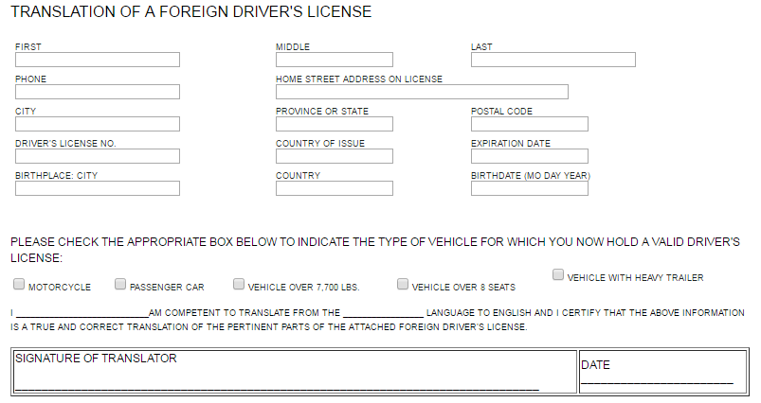
Translation: An “IDP” or similar translation is now required.

